Slide 1


Tmall 11.11
Repeat Buyers Prediction
by Frank, Joe, Diana

Slide 2
1
Background & Goal
2
Data Exploration
CONTENTS
3
Feature Engineering
4
Predictive Modeling
5
Results

Slide 3
1
Background & Goal

Slide 4
Background
Tmall runs big promotions on “Double 11” - the biggest online shopping event in China, in order to attract a large number of new buyers
Unfortunately, many of the attracted buyers are one-time deal hunters, and these promotions may barely a have long-lasting impact on sales
To reduce the promotion cost and enhance the return on investment (ROI), Tmall wants to identify who can be converted into repeated buyers

Slide 5
Goal
Predict the probability of the given user becoming a repeat buyer of the given merchant in the future
Identify the most important factor to predict repeat buyers

Slide 6
2
Data Exploration

Slide 7
Data Description
The data set is provided by Alibaba Cloud
The data set contains anonymized user’s shopping logs in the past 6 months before and on the “Double 11” day
Due to privacy issue, data is sampled in a biased way, so the statistical result on this data set would deviate from the actual of Tmall.com. But it will not influence the applicability of the solution.

Slide 8
Data Source
User Profile
age_range
gender
user_id

Slide 9
Research Questions
User Behavior logs
user_id
merchant_id
a unique id for the shopper
a unique id for the merchant
User Behavior Logs
item_id
brand_id
a unique id for the item
a unique id for the brand of the item
cat_id
time_stamp
a unique id for the category that the item belongs to
Date the action took place
action_type
click, add-to-cart, purchase, and add-to favorite
Notes:
action_type: set of interaction records between {user_id, merchant_id}, where each record is an action

Slide 10
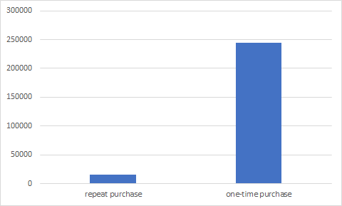
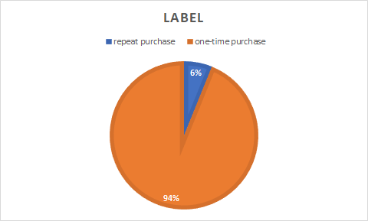
Data Source
Label
Imbalanced data: 94% are one-time purchases

Slide 11
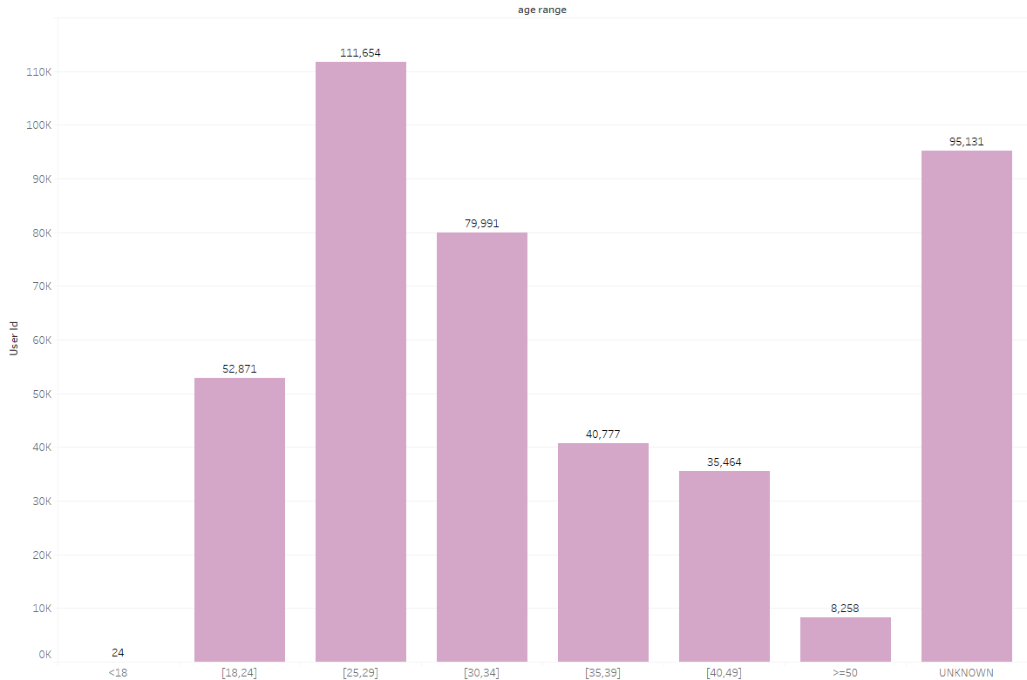
Data Source
User Age
Most of the users are between 25 and 29

Slide 12
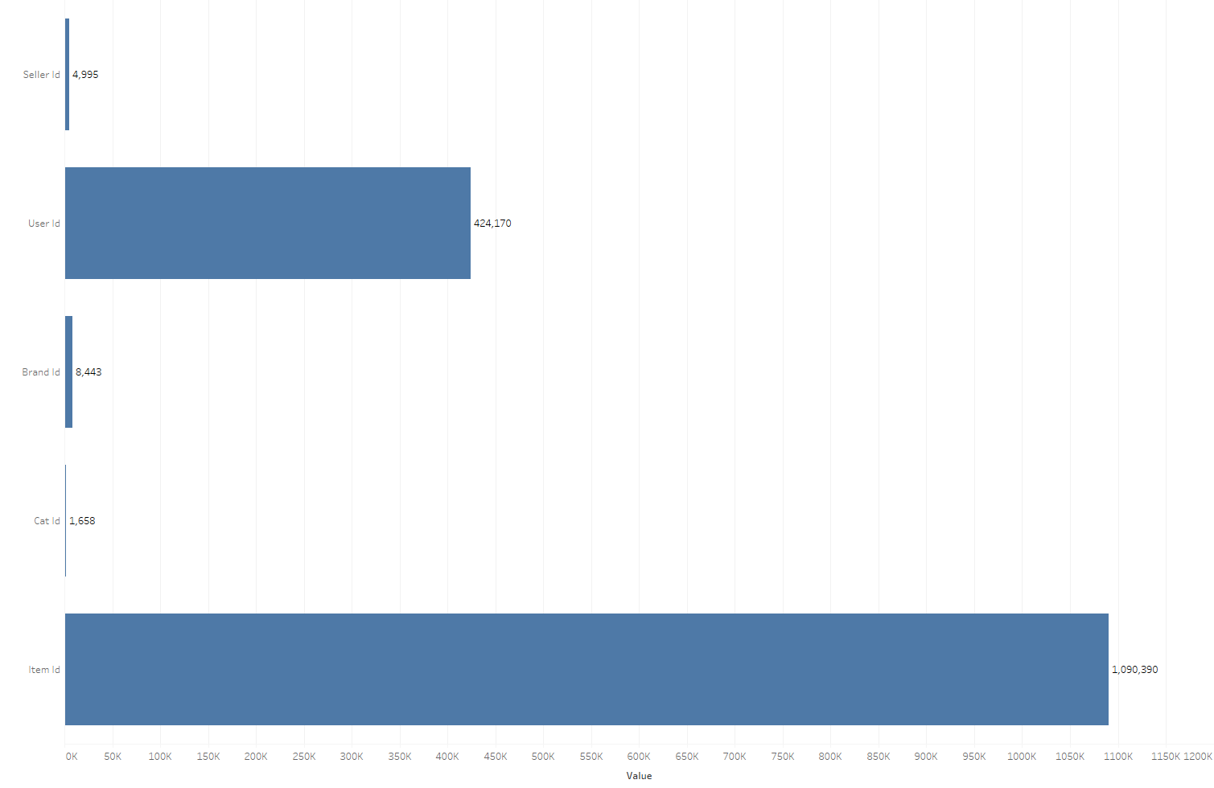
Data Source
Distinct # of ID
# of users is almost 100 times that of sellers
Millions of distinct items!
Notes:
top 10, others in category
distribution of category

Slide 13
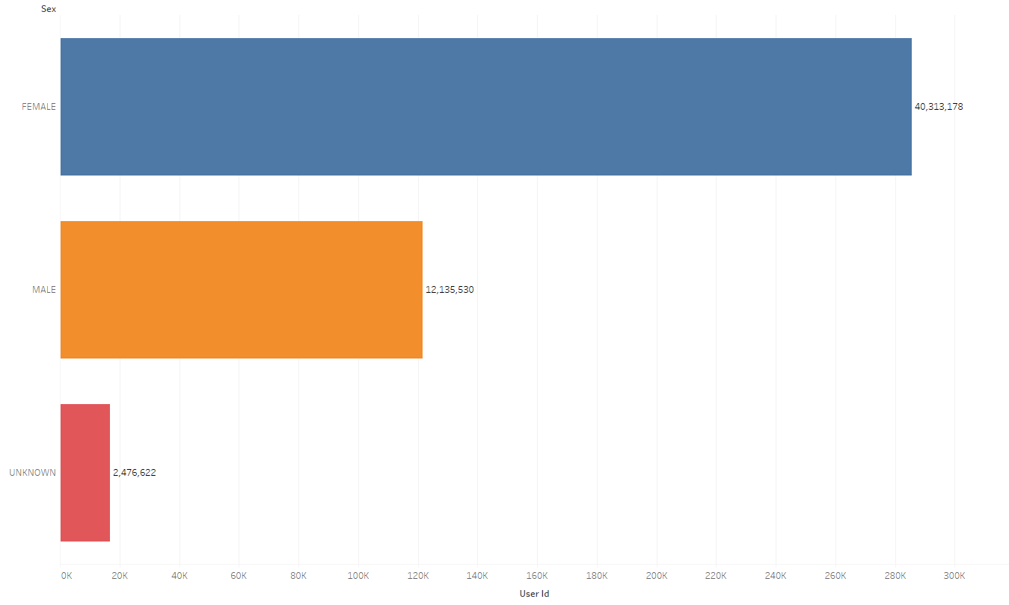
Data Source
User Gender
Most of the users are female

Slide 14
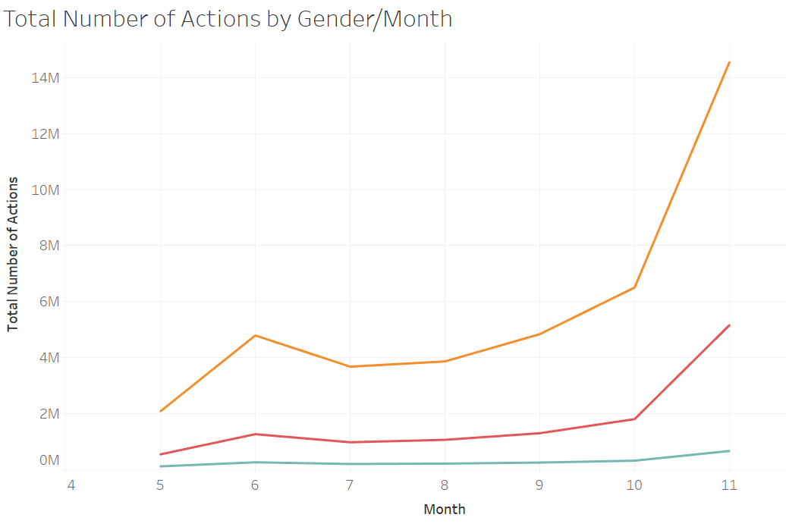
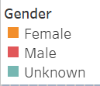
Data Source
Monthly Total Actions Trend by Gnder
Female group has the biggest volatility
Double 11
6.18
Mid-year Shopping Festival

Slide 15
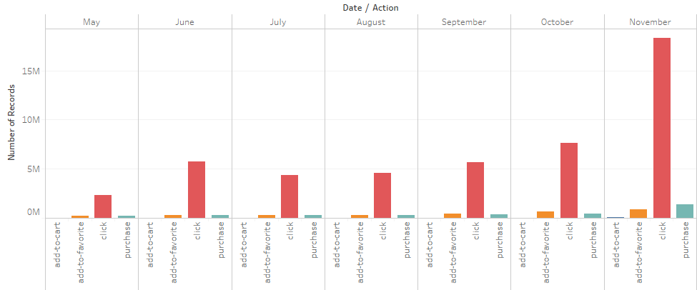
Data Source
Different Actions in Each Month
Customers like “window-shopping”

Slide 16
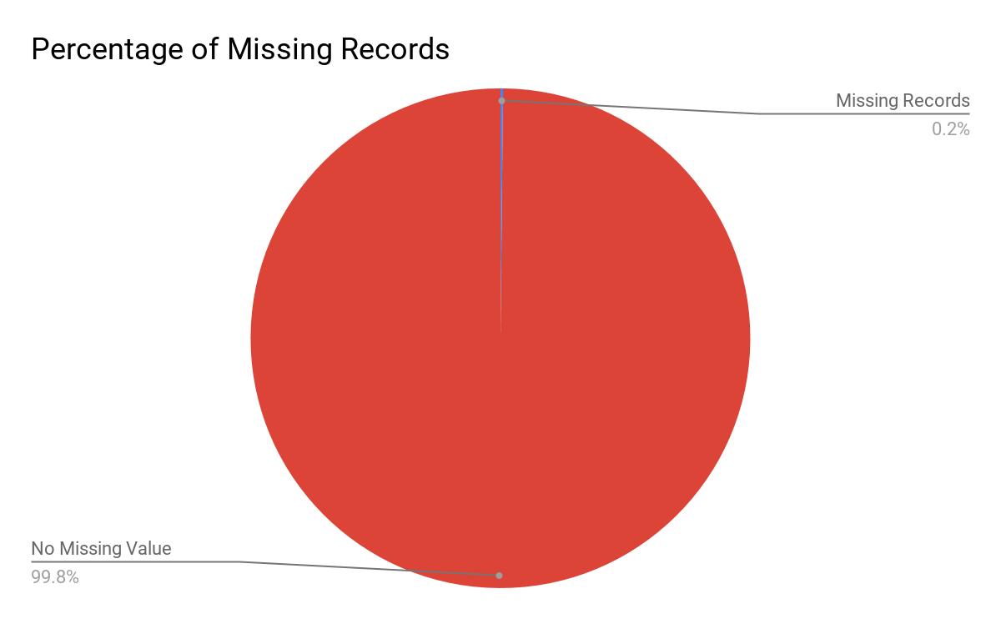
Data Source
Missing Data
We only have 0.2% of missingness in brand_id, which is not a big concern !

Slide 17
3
Feature Engineering

Slide 18
Action-based Features
Action counts are the numbers of clicks, purchases, add-to-favorites, and add-to-carts over the whole data period
user level
merchant level
user-merchant level
Purchase ratio is the proportion of purchase over all action types
user level
merchant level
user-merchant level

Slide 19
Day-based Features
Action day counts are the numbers of days with a particular action type over the whole data period
user level
merchant level
user-merchant level
Purchase day ratio is the proportion of the number of days with purchase(s) over the number of total active days
mainly used to differentiate regular buyers from occasional buyers
E.g. a user with 10 purchase actions in one single day is different from another user with the same number of purchase actions that spread over 10 different days. The latter user is considered a more regular buyer than the former.

Slide 20
Product Diversity Features
Product diversity are the numbers of unique items, brands and categories that the user clicked, purchased, added to cart, or added to favorites over the whole data period
user level
merchant level
user-merchant level
The intuition behind product diversity features is that if a user is interested in more items of a merchant, then the user is more likely to buy again from the merchant

Slide 21
11.11 Recent Activity Features
Counts and ratios of clicks, purchases, add-to-favorites, and add-to-carts on the Double 11 day, in the last one week before Double 11, and in the last one month before Double 11
E.g. double 11 purchase ratio = # of purchase on 11.11 / total # of purchase
If a user has a high Double 11 buy ratio, then the user is more likely to be a one-time deal hunter

Slide 22
Merchant’s Market Share Features
Intermidiate features: used to compute similarity scores
merchant-brand level
merchant-category level
Merchant’s market share measures how important a merchant is to a brand/category
merchant’s market share on the brand/category =
# of actions of the brand/category from the merchant
# of actions of the brand/category from all the merchants

Slide 23
User-Merchant Similarity Features
User-merchant similarity measures how similar a user and a merchant are, based on brands or categories
user-merchant level
Similarity scores are calculated based on the merchant’s market share features and the preferences of users on brands/categories
user’s preference on the brand/category = # of actions on the brand/category
user-merchant similarity score = merchant’s market share × user’s preference
E.g. a merchant has 5 brands with respective market shares (0.1, 0.2, 0.05, 0.3, 0.01), and the number of times of a user buying the 5 brands are (0, 1, 2, 0, 2), then the brand similarity score is the sum of inner product of merchant’s market share and user’s preference: 0.1 × 0 + 0.2 × 1 + 0.05 × 2 + 0.3 × 0 + 0.01 × 2 = 0.32

Slide 24
Research Questions
Feature Summary
Action-based features
Product diversity
# of each action
# of total actions
% of purchase
ueser, merchant, user-merchant
# of unique items/categories/brands
ueser, merchant, user-merchant
81 features
User-merchant similarity
similarity score on brands/categories
user-merchant
Day-based features
# of days of each action
# of total active days
% of days with purchase
ueser, merchant, user-merchant
11.11 Recent Activity
Double 11/Latest one-week/Latest one-month features
# of each action
% of each action
user-merchant

Slide 25
4
Predictive Modeling

Slide 26
Goal and Hypothesis
Modeling Steps
Balance Data
Evaluation
SMOTE
RandomUnderSampler
ADASYN
Time Efficiency
Accuracy
AUC
Baseline Models
Re-Train Models
Random Forest
GBM
XGBoost
w/ balanced data
5-fold cross validation

Slide 27
Split Data
Randomly split data into
Training set: 70%, for model training
Testing set: 30%, held-out data for evaluating performance

Slide 28
Train Baseline Models
First we use the original data to train baseline models with 3 different algorithms
Random Forest
GBM
XGBoost

Slide 29
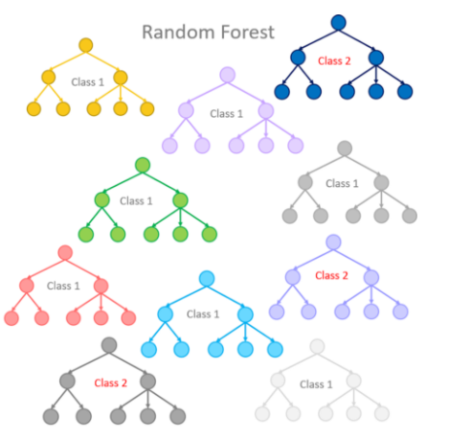
Bagging
Random Forest
Create a large number of decisions trees based on bagging
Resample the data over and over and for each sample train a new classifier
Each iteration the classifier is trained independently from the rest
Different classifiers overfit the data in a different way, and through voting those differences are averaged out

Slide 30

Gradient Boosting
GBM (Gradient Boosting Machine)
A boosting method builds on weak classifiers
Trees are trained sequentially
Add a classifier at a time, so that the next classifier is trained to improve the already trained ensemble
XBGoost
An implementation of gradient boosted decision trees designed for speed and performance
A more flexible and efficient version of GBM

Slide 31
Baseline Performance
Baseline results are worrisome
Models are biased and overfitting
Reason might be the extremely imbalance labels in data with 94% 0s
 | Random Forest | GBM | XGBoost
Accuracy | 0.938 | 0.938 | 0.938
AUC | 0.627 | 0.663 | 0.669
Mean Prediction | 0.000178 | 0.0 | 0.000128

Slide 32
Traditional Techniques to Balance Data
RandomUnderSample
It deletes the records from the majority class label to match the minority class label
We will lose a lot of information as most of the records are deleted
RandomOverSample
It randomly duplicates the records from the minority class.
While it increases the number of data, it does not give any new information or variation to the machine learning model

Slide 33
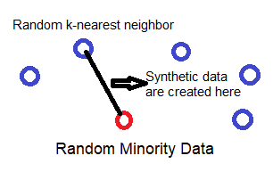
Balance Data
SMOTE (Synthetic Minority Oversampling TEchnique)
SMOTE works by utilizing a k-nearest neighbor algorithm to create synthetic data
First start by choosing random data from the minority class then k-nearest neighbors from the data are set
Synthetic data would then made between the random data and the randomly selected k-nearest neighbor

Slide 34
Balance Data
ADASYN (Adaptive Synthetic Method for Imbalanced Data)
Another oversampling technique
The major difference between SMOTE and ADASYN is the difference in the generation of synthetic sample points for minority data points:
In ADASYN, we consider a density distribution which decides the number of synthetic samples to be generated for a particular point
whereas in SMOTE, there is a uniform weight for all minority points.

Slide 35
Iteration
Balance data with 3 different methods
RandomUnderSample
SMOTE
ADASYN
Re-train models with stratified 5-fold cross-validation, with the 3 sampling schemes
Random Forest
GBM
XGBoost

Slide 36
5
Results

Slide 37
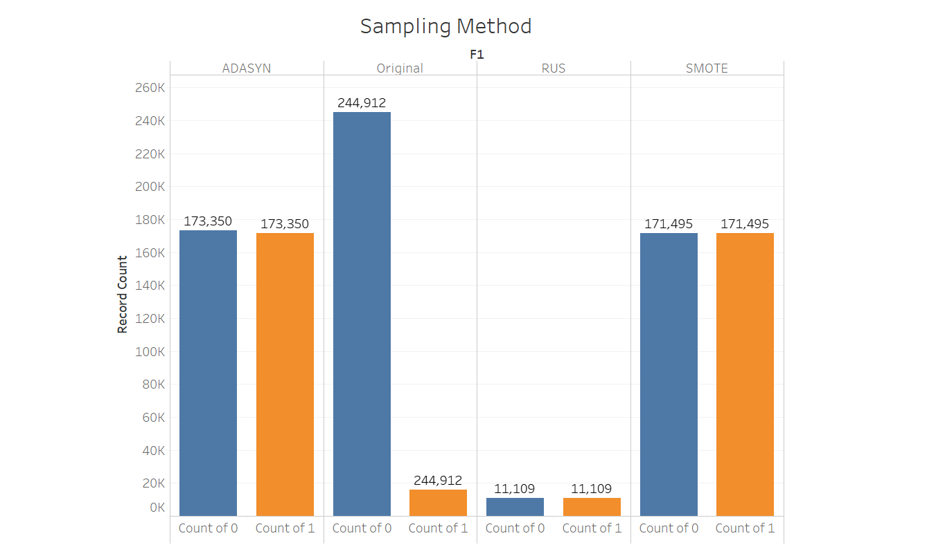
Balanced Data

Slide 38
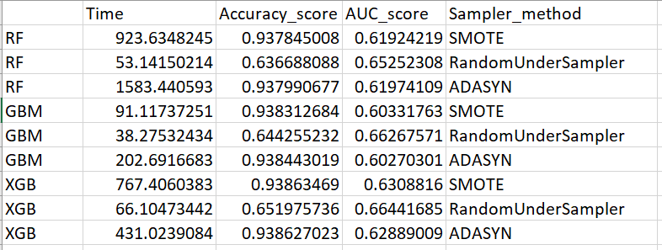
Performance Evaluation
XGBoost with SMOTE has the best accuracy

Slide 39
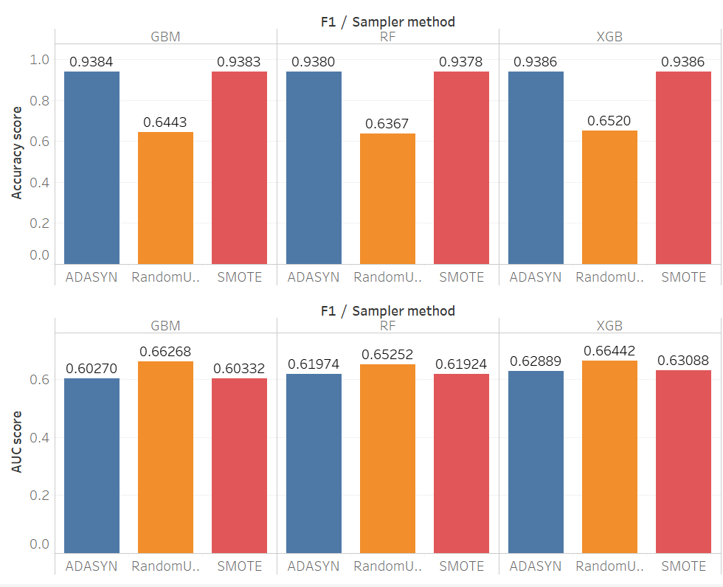
Performance Evaluation

Slide 40
Feature Importance
Feature Importance
A score to indicate how useful each feature is at predicting the target variable
A feature is "important" if shuffling its values increases the model error, because in this case the model relied on the feature for the prediction
A feature is "unimportant" if shuffling its values leaves the model error unchanged, because in this case the model ignored the feature for the prediction
Gini Importantce
Calculates each feature importance as the sum over the number of splits (across all trees) that include the feature, proportionally to the number of samples it splits
Information Gain
How much information with respect to the label the feature gives you

Slide 41
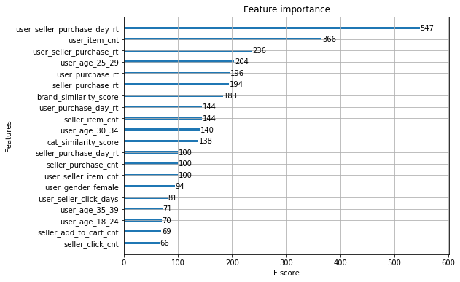
Feature Importance
Gini Importance

Slide 42
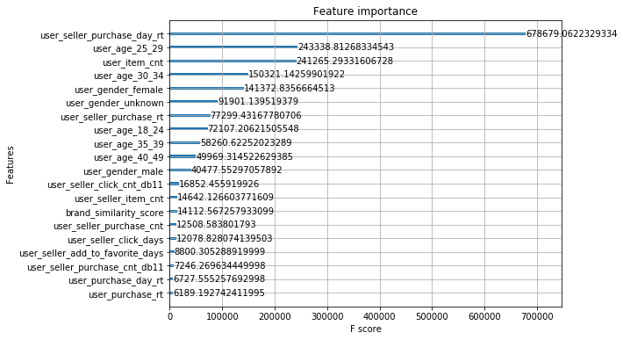
Feature Importance
Information Gain

Slide 43
Final Thoughts
User-seller purchase day ratio is the most powerful feature to predict the repeated purchases
a user with 10 purchase actions in one single day is more likely to be a repeat buyer than another user with the same number of purchase actions that spread over 10 different day
Sellers should pay more attention to regular buyers in order to gain customer loyalty
Balance could greatly influence model performace

Slide 44
Thank You!
Q&A

